Slide 1
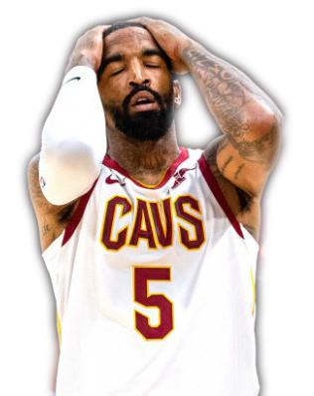

DETERMINING THE EFFECT OF Recreational Drugs On ATHLETIC PERFORMANCE
Ryan Cheong, Miko Farin
STATS 101B – Lec 1

Slide 2
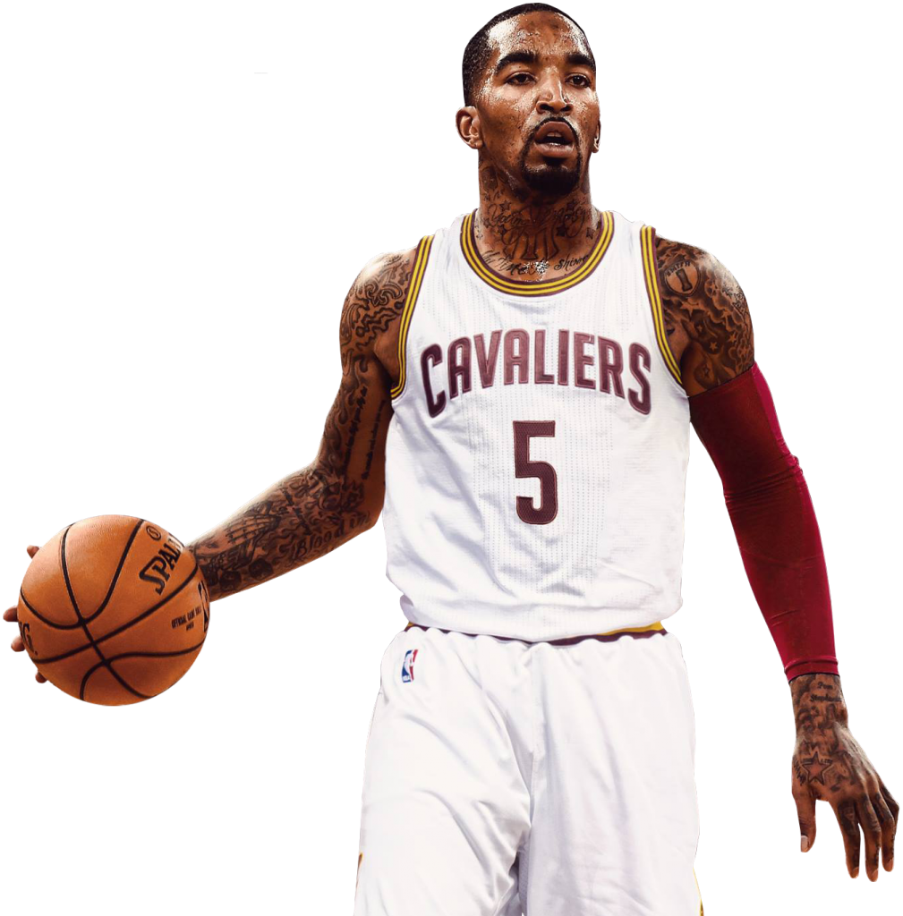
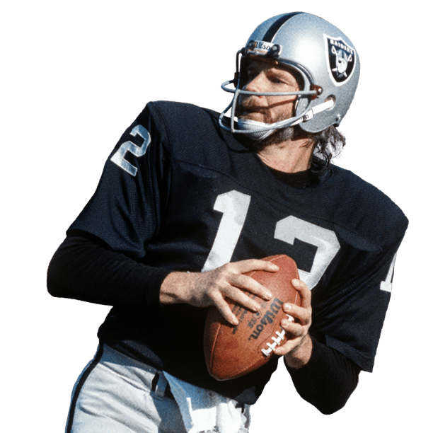
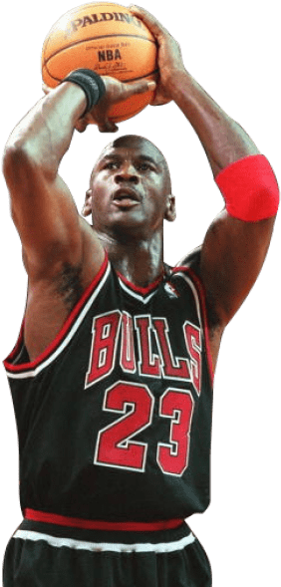
INTRODUCTION
MOTIVATION
Situation: As humans at their very core, athletes too tend to indulge in the consumption of drugs such as tobacco, marijuana, and alcohol on a regular basis – and at certain times, its over-consumption. But to extent, it at all, does a “night out” and this behavior have on their performance the following day?
JR SMITH
KEN STABLER
MICHAEL JORDAN
2

Slide 3
INTRODUCTION
LITERATURE REVIEW
Whether athletes feel pressure to celebrate with alcohol or they enjoy drinking, research shows college athletes binge-drink more than non-athletes…
Marijuana has been scientifically proven to hinder performance in sports, impair judgement, and agility, slow motor skills, and inhibit awareness
In some sports, up to half the team uses nicotine in various forms, mostly as smokeless chewing tobacco…
”
”
”
Nancy Clark, M.S., R.D., CSSD
Stanford Office of Alcohol Policy and Education
Toby Mündel, Senior Lecturer Massey University
3

Slide 4



RESEARCH QUESTIONS
Are there significant effects on the athletic performance of Islanders with the use of marijuana, tobacco, and alcohol the night prior to an athletic event?
Is there significant interaction between the dosage and type of drug?
What are the treatments that will have significant differences in athletic performance?
4

Slide 5
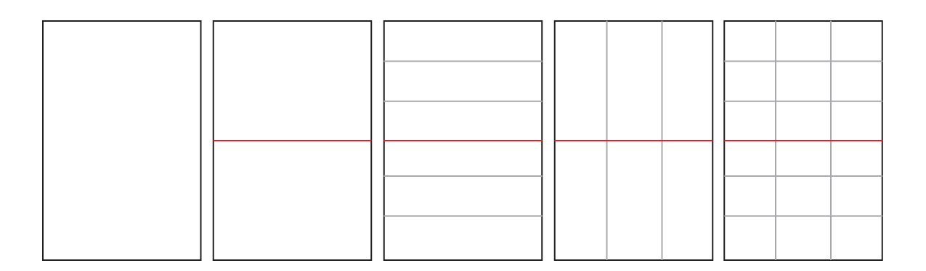
DESIGN & METHODOLOGY
DESIGN
BLOCK: Gender
df = 1
BENCHMARK
df = 1
TREATMENT: DRUG (Alcohol, THC, Control)
df = 2
TREATMENT: DOSAGE (Low, Medium, High)
df = 2
INTERACTION: DRUG x DOSAGE
df = 4
5

Slide 6
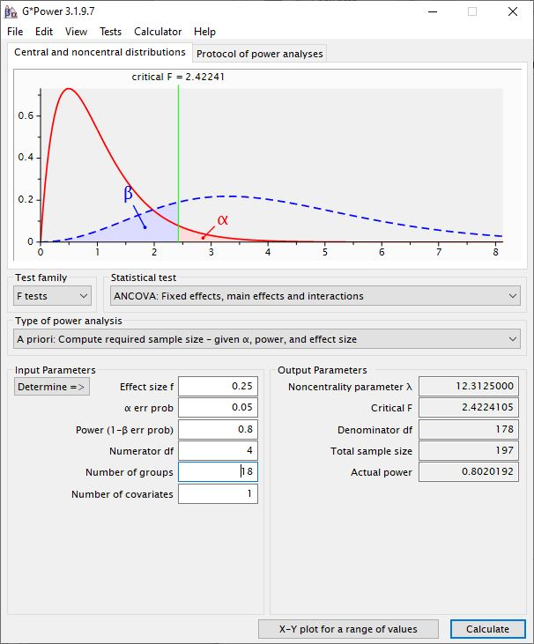
DESIGN & METHODOLOGY
SAMPLING
POWER
In order to represent professional athletes, we aim to sample Islanders between the ages 18 and 40
No bias towards a person based on underlying health conditions are made
Consent from all participants obtained
18
11
198
GROUPS
PER GROUP
PARTICIPANTS
6

Slide 7


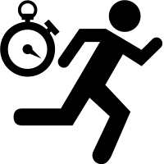

PROCEDURE
03 TREATMENTS
01 SAMPLING
Apply randomly assigned treatments within each block
Obtain a list of Islanders
05 DATA ANALYSIS
Import data into R and perform ANOVA to determine statistical significance
Measure post-treatment measurements after passage of at least 12 hours from treatment
Record pre-treatment measurements on day 1 at noon
04 POST-TREATMENT
MEASUREMENT
02 PRE-TREATMENT
MEASUREMENT
7

Slide 8
ANALYSIS
SUMMARY
ALCOHOL (FEMALE)
THC (MALE)
 | Pre-Treatment Coordination |  | Post-Treatment Coordination |  | Pre-Treatment Performance |  | Post-Treatment Performance
`Dosage | Mean | Std. Dev | Mean | Std. Dev. | Mean | Std. Dev | Mean | Std. Dev.
60mL (Low) | 37.3 | 5.27 | 36.5 | 4.99 | 17.6 | 5.16 | 17.6 | 5.26
120mL (Med) | 32.5 | 4.66 | 34.0 | 5.55 | 18.8 | 4.17 | 19.3 | 4.50
180mL (High) | 37.3 | 4.82 | 38.1 | 5.22 | 16.0 | 3.01 | 15.9 | 2.89
 | Pre-Treatment Coordination |  | Post-Treatment Coordination |  | Pre-Treatment Performance |  | Post-Treatment Performance
`Dosage | Mean | Std. Dev | Mean | Std. Dev. | Mean | Std. Dev | Mean | Std. Dev.
1 blunts | 41.0 | 5.18 | 40.0 | 5.08 | 16.5 | 3.92 | 16.7 | 3.91
3 blunts | 37.5 | 3.98 | 37.1 | 4.01 | 18.4 | 4.38 | 18.6 | 4.62
5 blunts | 37.3 | 4.52 | 37.3 | 6.90 | 16.3 | 3.37 | 16.6 | 3.53
8

Slide 9
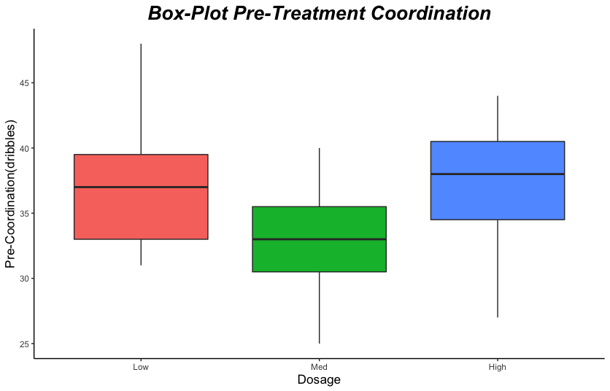
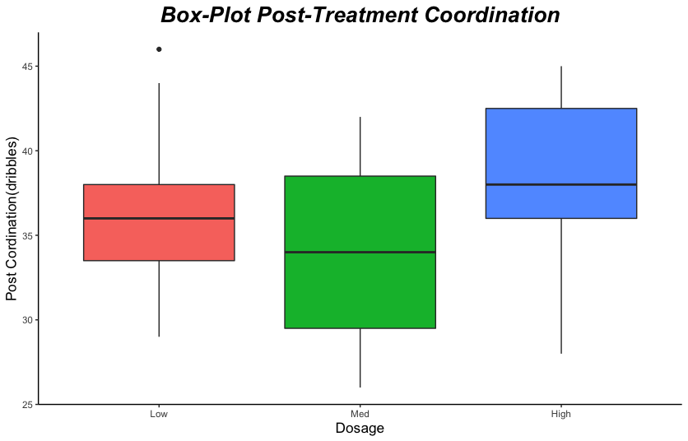
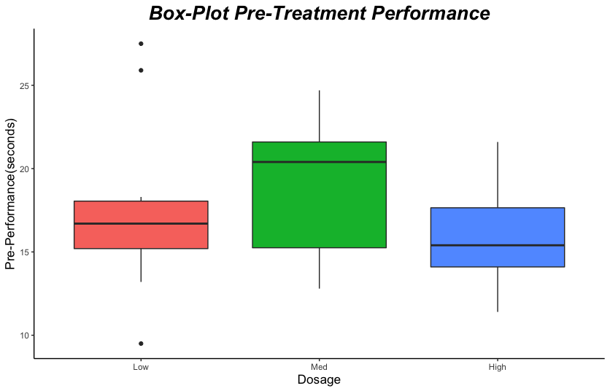
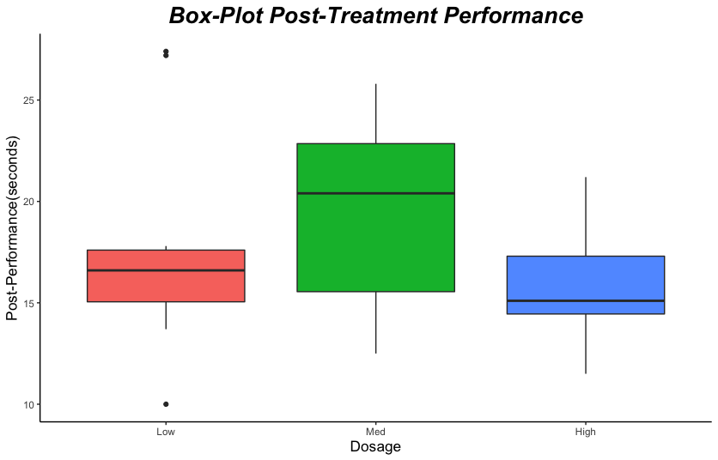
ANALYSIS
SUMMARY
ALCOHOL (FEMALE)
9

Slide 10
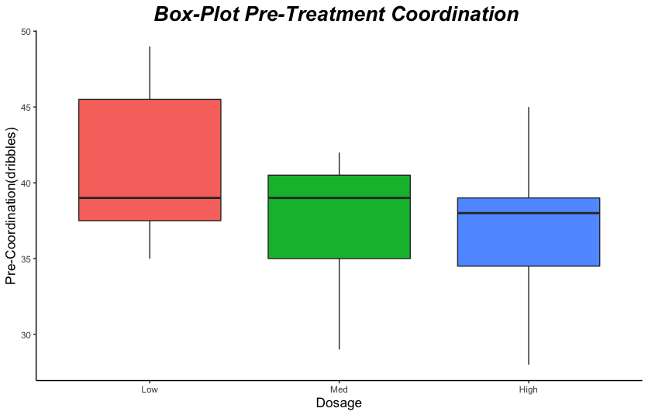
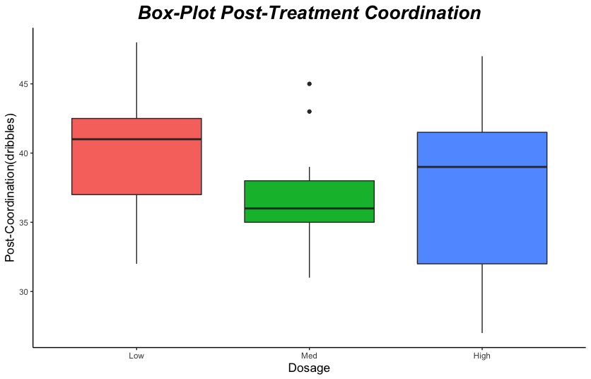
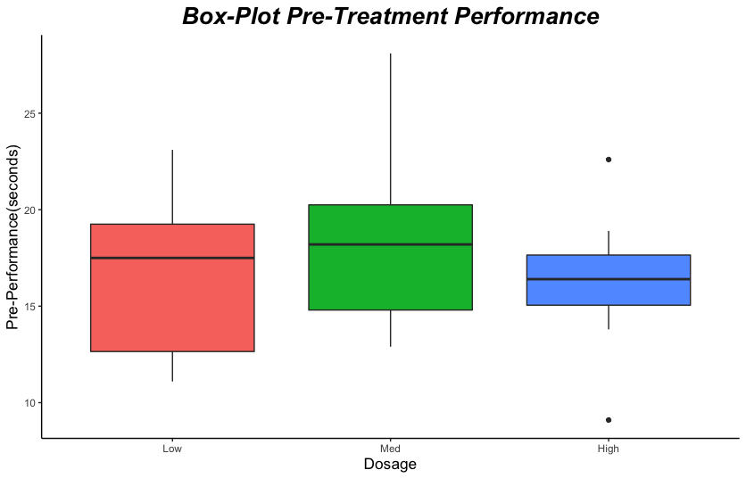
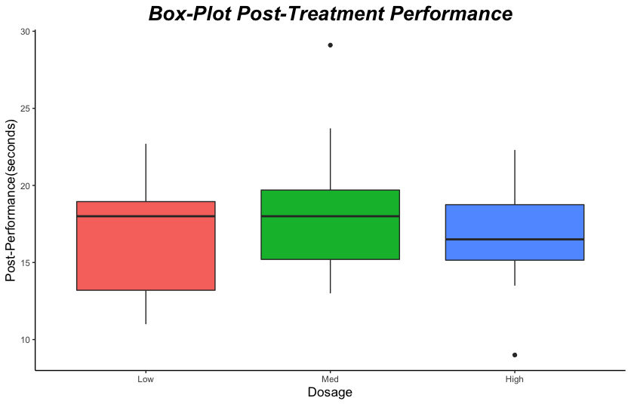
ANALYSIS
SUMMARY
THC (MALE)
10

Slide 11
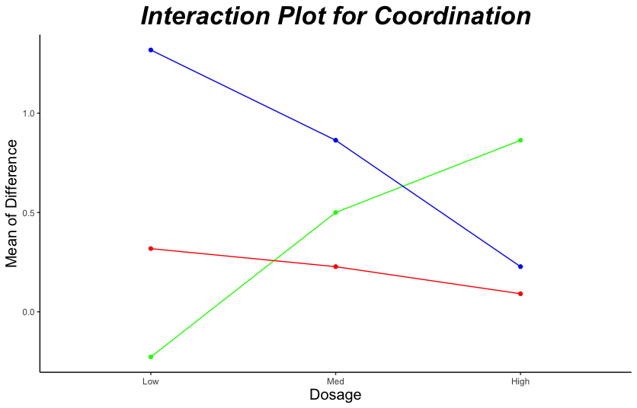
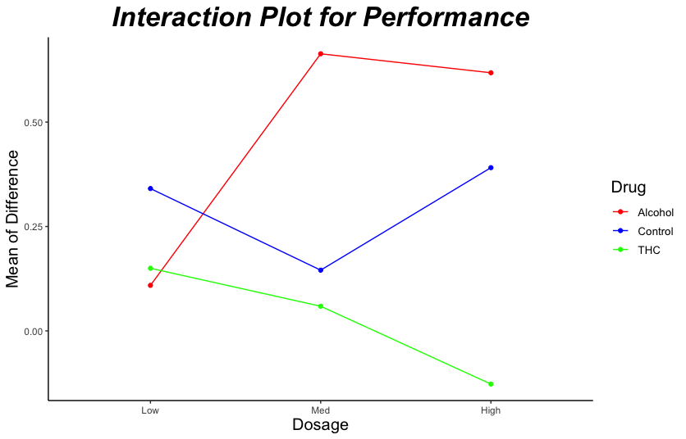
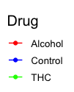
ANALYSIS
SUMMARY
11

Slide 12
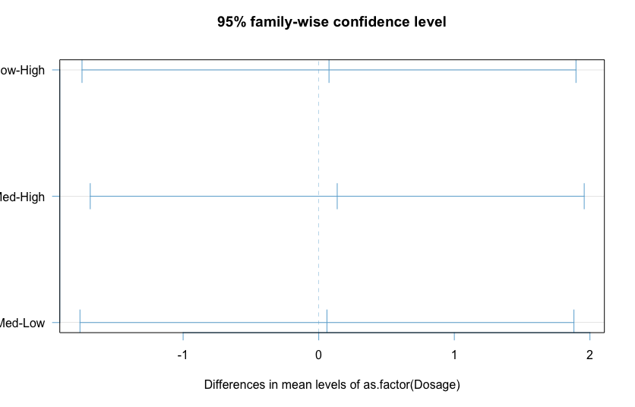
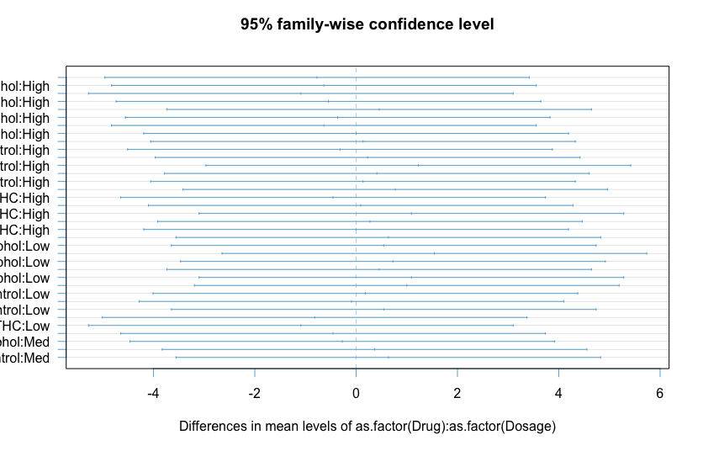
ANALYSIS
SUMMARY
12

Slide 13
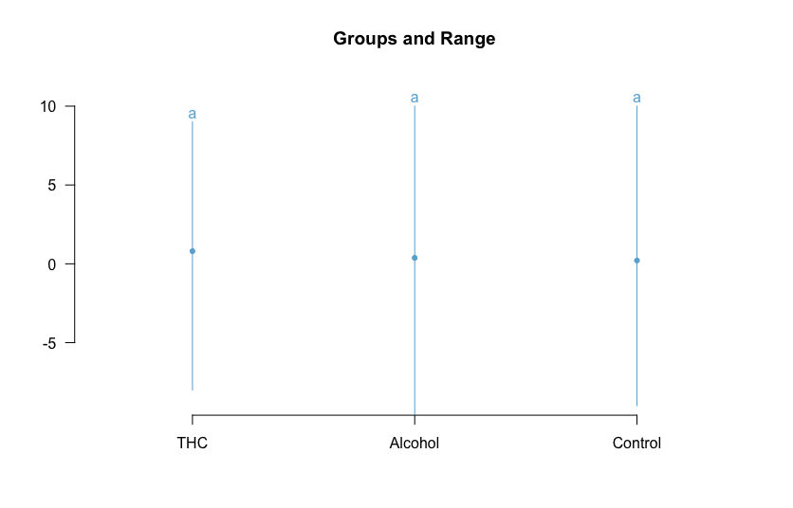
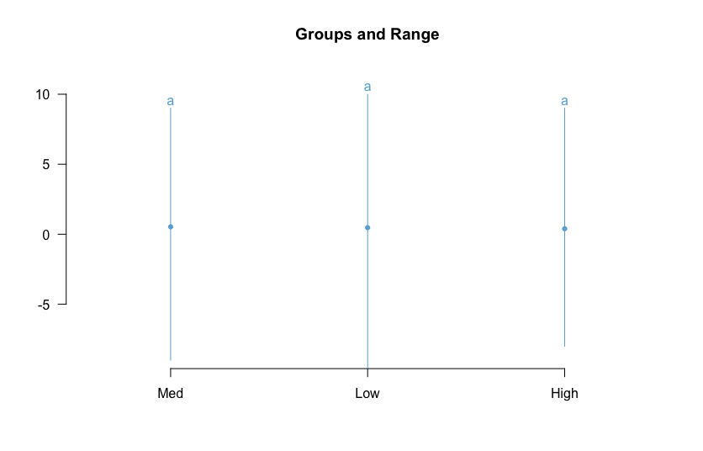
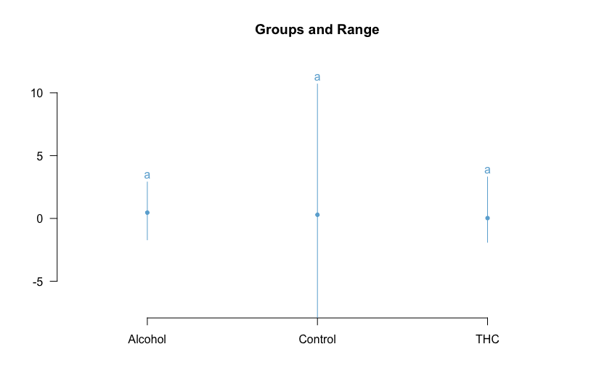
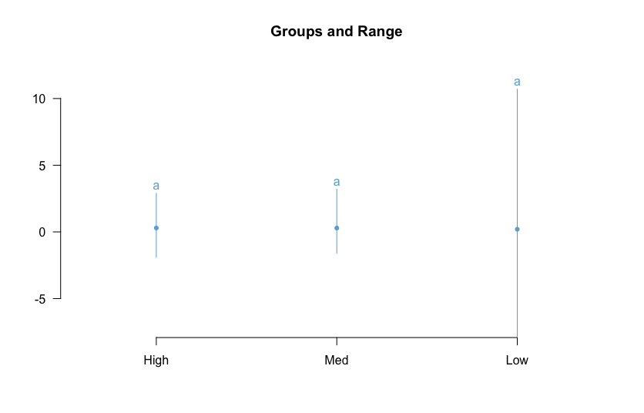
ANALYSIS
SUMMARY
LSD Fisher Test
Coordination
Performance
13

Slide 14
ANALYSIS
TWO-WAY ANOVA WITH ONE BLOCK
COORDINATION
0.732
0.984
 | Df | Sum Sq. | Mean Sq. | F value | Pr(>F)
Gender | 1 | 68.0 | 67.960 | 3.4646 | 0.06426
Drug | 2 | 12.3 | 6.126 | 0.3123 | 0.73213
Dosage | 2 | 0.6 | 0.308 | 0.0157 | 0.98442
Drug:Dosage | 4 | 26.7 | 6.687 | 0.3409 | 0.85010
Residuals | 188 | 3687.7 | 19.615
DRUG (p-value)
DOSAGE (p-value)
0.850
INTERACTION (p-value)
PERFORMANCE
0.233
0.918
 | Df | Sum Sq. | Mean Sq. | F value | Pr(>F)
Gender | 1 | 9.04 | 9.0368 | 4.1530 | 0.04296
Drug | 2 | 6.38 | 3.1904 | 1.4662 | 0.23343
Dosage | 2 | 0.37 | 0.1852 | 0.0851 | 0.91844
Drug:Dosage | 4 | 5.42 | 1.3550 | 0.6227 | 0.64687
Residuals | 188 | 409.08 | 2.1760
DRUG (p-value)
DOSAGE (p-value)
0.646
INTERACTION (p-value)
14

Slide 15
ANALYSIS
TWO-WAY ANOVA CONT.
COORDINATION
PERFORMANCE
 | Df | Sum Sq. | Mean Sq. | F value | Pr(>F)
Age | 2 | 51.8 | 25.893 | 1.3071 | 0.2731
Drug | 2 | 9.3 | 4.6726 | 0.2359 | 0.7901
Dosage | 2 | 1.6 | 0.7754 | 0.0391 | 0.9616
Drug:Dosage | 4 | 28.1 | 7.0182 | 0.3543 | 0.8408
Residuals | 187 | 3704.5 | 19.8101
 | Df | Sum Sq. | Mean Sq. | F value | Pr(>F)
Age | 2 | 0.37 | 0.1832 | 0.0821 | 0.9212
Drug | 2 | 6.33 | 3.1629 | 1.4176 | 0.2449
Dosage | 2 | 0.49 | 0.2460 | 0.1102 | 0.8957
Drug:Dosage | 4 | 5.88 | 1.4689 | 0.6583 | 0.6217
Residuals | 187 | 417.23 | 2.2312
COORDINATION (WITH TWO BLOCKS)
 | Df | Sum Sq. | Mean Sq. | F value | Pr(>F)
Age | 2 | 51.8 | 25.893 | 1.3190 | 0.26988
Gender | 1 | 54.4 | 54.441 | 2.7733 | 0.09753
Drug | 2 | 9.6 | 4.823 | 0.2457 | 0.78244
Dosage | 2 | 1.2 | 0.583 | 0.0297 | 0.97072
Drug:Dosage | 4 | 27.0 | 6.738 | 0.3433 | 0.84847
Residuals | 186 | 3651.3 | 19.630
*Note that sample size determinations and power testing may differ.
15

Slide 16
ANALYSIS
THREE-WAY REPEATED MEASURES ANOVA
COORDINATION
PERFORMANCE
ERROR: PARTICIPANT
ERROR: PARTICIPANT
 | Df | Sum Sq. | Mean Sq. | F value | Pr(>F)
Drug | 2 | 44 | 21.95 | 0.481 | 0.619
Dosage | 2 | 109 | 54.61 | 1.197 | 0.305
Drug:Dosage | 4 | 264 | 66.02 | 1.447 | 0.221
Residuals | 176 | 8032 | 45.63
 | Df | Sum Sq. | Mean Sq. | F value | Pr(>F)
Drug | 2 | 0 | 0.06 | 0.002 | 0.998
Dosage | 2 | 14 | 7.03 | 0.221 | 0.802
Drug:Dosage | 4 | 235 | 58.67 | 1.844 | 0.122
Residuals | 176 | 5598 | 31.81
ERROR: PARTICIPANT:TIME
ERROR: PARTICIPANT:TIME
 | Df | Sum Sq. | Mean Sq. | F value | Pr(>F)
Time | 1 | 21.4 | 21.374 | 2.177 | 0.142
Drug:Time | 2 | 0.9 | 0.426 | 0.043 | 0.958
Dosage:Time | 2 | 1.8 | 0.919 | 0.094 | 0.911
Drug:Dosage:Time | 4 | 12.7 | 3.178 | 0.324 | 0.862
Residuals | 176 | 1728.1 | 9.819
 | Df | Sum Sq. | Mean Sq. | F value | Pr(>F)
Time | 1 | 6.75 | 6.750 | 7.400 | 0.00718
Drug:Time | 2 | 2.35 | 1.175 | 1.288 | 0.27837
Dosage:Time | 2 | 1.09 | 0.543 | 0.595 | 0.55260
Drug:Dosage:Time | 4 | 1.16 | 0.291 | 0.319 | 0.86528
Residuals | 176 | 160.53 | 0.912
*Note that sample size determinations and power testing may differ.
16

Slide 17
CONCLUSION
SITUATION
Objective: The purpose of this study was to find and examine the negative effects of THC and alcohol on athletic performance to determine if athletes’ behavior and habits may affect their performance.
Applications: The results address the concerns some athletes may or may not have regarding their performance the following day, allowing for them to better understand the consequences of their decisions (or misdecisions).
RESULTS
The mean differences between coordination and performance before and after consumption of recreational drugs did not have a statistically significant effect on Islanders the following day.
At α = 0.1, blocking for gender was statistically significant in both measures, suggesting that by blocking on gender, that particular source of variability is not only controlled, but also reduced.
17

Slide 18
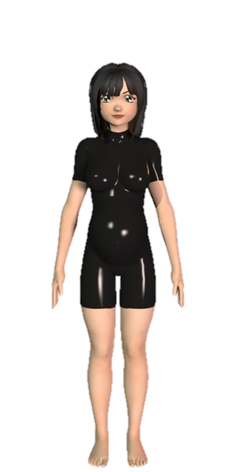
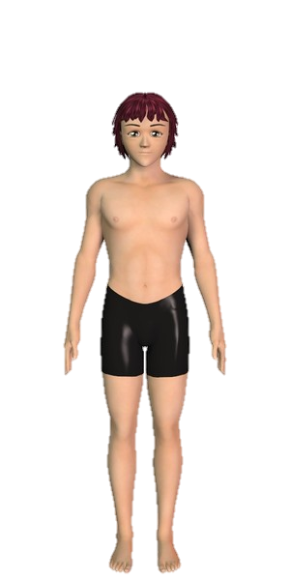
CONSIDERATIONS & LIMITATIONS
.01
.02
HANGOVER EFFECT
5X5 LATIN SQUARE
Hypothesized that the Island does not capture hangover effects
Considered a LS design, but required an interaction between dosage and drug
.03
.04
SLEEP
LONG-TERM EFFECTS
Suspected that Islanders do not have late nights since each tends to sleep at a set time
Thought the effects of drugs may be better measured long-term (known to induce injuries)
.05
.06
GEOGRAPHIC REGION
RESPONSE VARIABLES
Assumed that geographic variability did not have an effect on within group variance
Decided to measure coordination and performance based on two, short-lasting measures
18

Slide 19
REFERENCES
Zeiger, Joanna S et al. “Cannabis use in active athletes: Behaviors related to subjective effects.” PloS one vol. 14,6 e0218998. 28 Jun. 2019
https://www.ncbi.nlm.nih.gov/pmc/articles/PMC6598761/
Ware, Mark A et al. “Cannabis and the Health and Performance of the Elite Athlete.” Clinical journal of sport medicine : official journal of the Canadian Academy of Sport Medicine, Canadian Academy of Sport Medicine, 2018 Aug 28
https://www.ncbi.nlm.nih.gov/pmc/articles/PMC6116792/
Reardon, Claudia L, and Shane Creado. “Drug abuse in athletes.” Substance abuse and rehabilitation, 14 Aug. 2014,
https://www.ncbi.nlm.nih.gov/pmc/articles/PMC4140700/
Latham, Andrew. "Physiological Differences Between Male and Female Athletes." Work - Chron.com, 28 June 2018.
https://work.chron.com/physiological-differences-between-male-female-athletes-20627.html
Lachenmeier, Dirk W, and Patrick Diel. “A Warning against the Negligent Use of Cannabidiol in Professional and Amateur Athletes.” Sports (Basel, Switzerland). 14 Dec. 2019,
https://www.ncbi.nlm.nih.gov/pmc/articles/PMC6956040/
Borchers, Callum. “From TD To CBD: Gronkowski Is Now In The Business Of Cannabis, Not Touchdowns.” Bostonomix, WBUR, 27 Aug. 2019, www.wbur.org/bostonomix/2019/08/27/from-td-to-cbd-gronkowski-is-now-in-the-business-of-cannabis-not-touchdowns.
Vella, Luke D, and David Cameron-Smith. “Alcohol, athletic performance and recovery.” Nutrients, 2010 Aug, https://www.ncbi.nlm.nih.gov/pmc/articles/PMC3257708/
David A. Yusko PsyD, Jennifer F. Buckman PhD, Helene R. White PhD & Robert J. Pandina PhD (2008) Alcohol, Tobacco, Illicit Drugs, and Performance Enhancers: A Comparison of Use by College Student Athletes and Nonathletes, Journal of American College Health, 06 Aug 2010
https://www.tandfonline.com/doi/abs/10.3200/JACH.57.3.281-290
19

Slide 20
APPENDIX

Slide 21
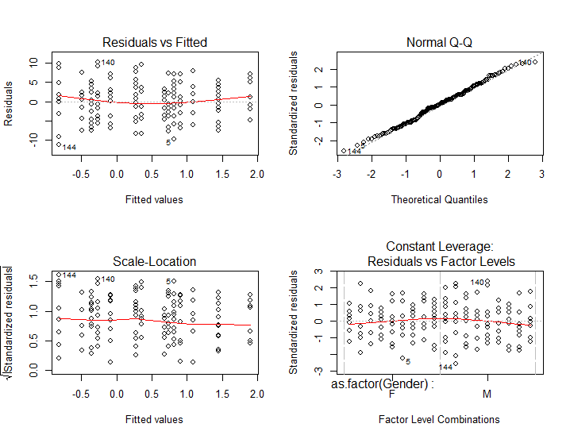
MODEL VALIDITY (COORD.)

Slide 22
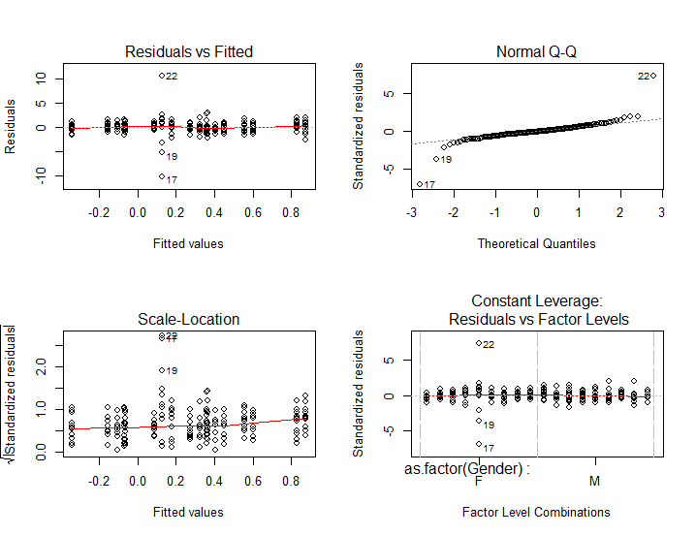
MODEL VALIDITY (COORD.)

Slide 23
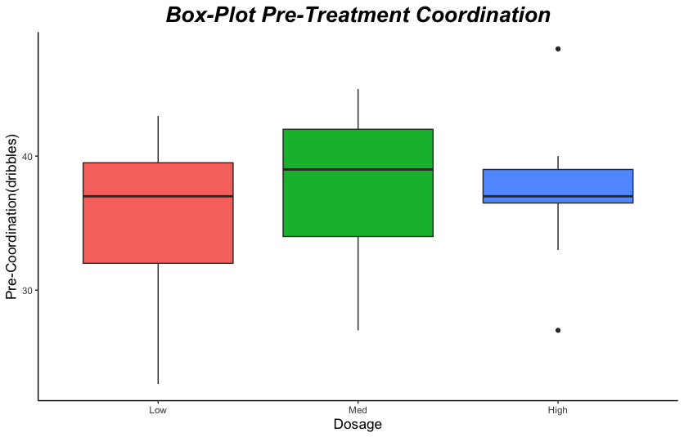
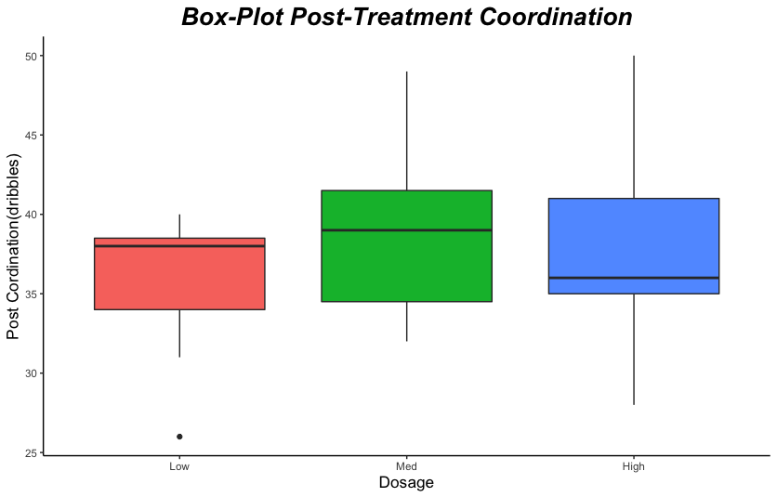
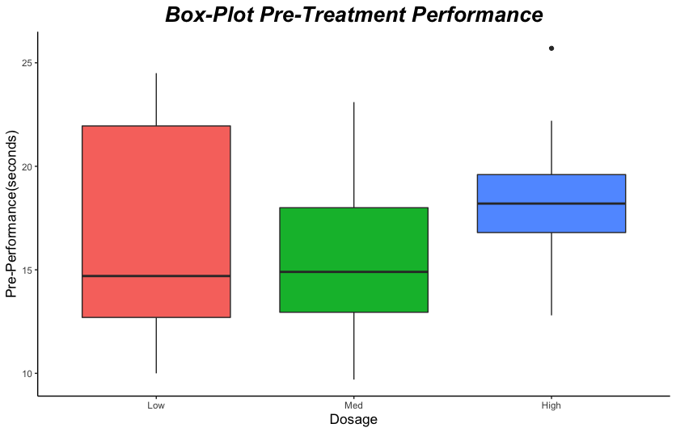
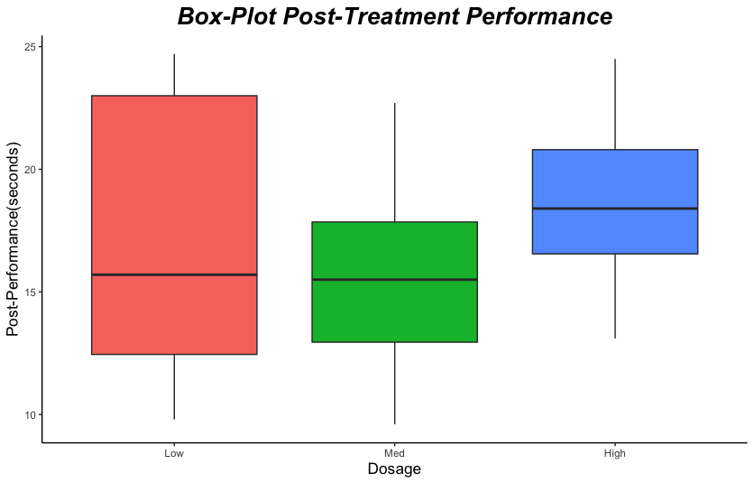
ANALYSIS
SUMMARY
CONTROL (FEMALE)
23

Slide 24
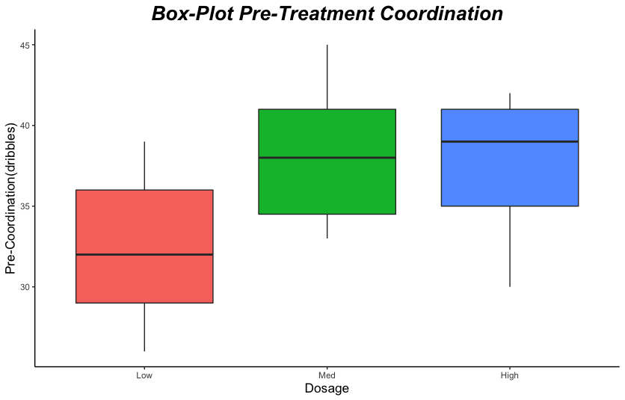
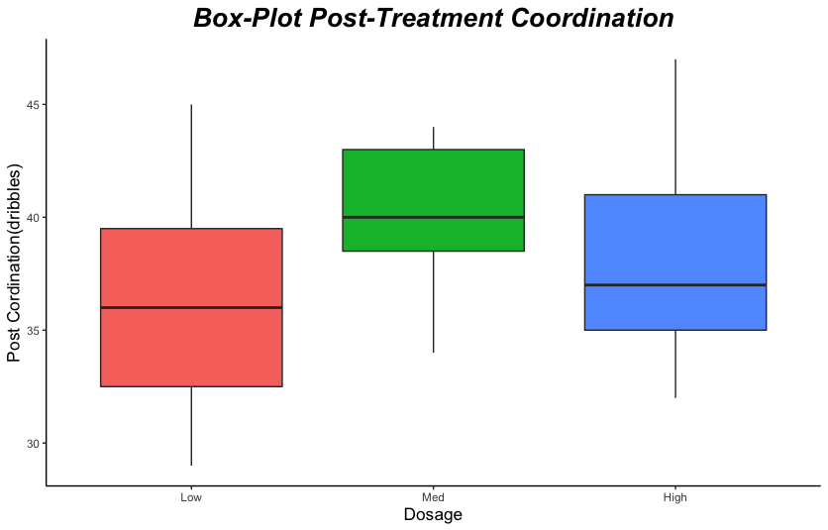
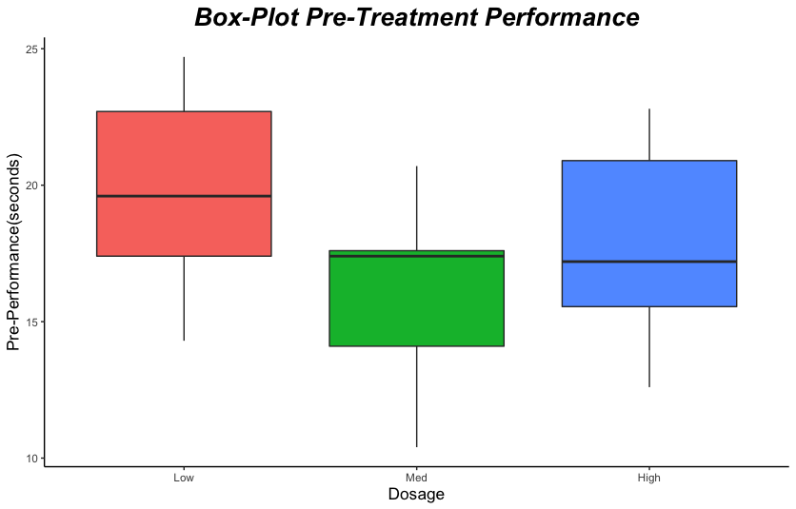
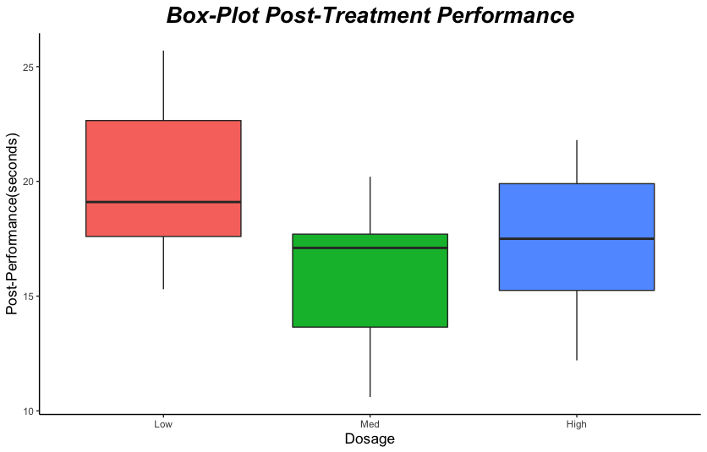
ANALYSIS
SUMMARY
THC (FEMALE)
24

Slide 25
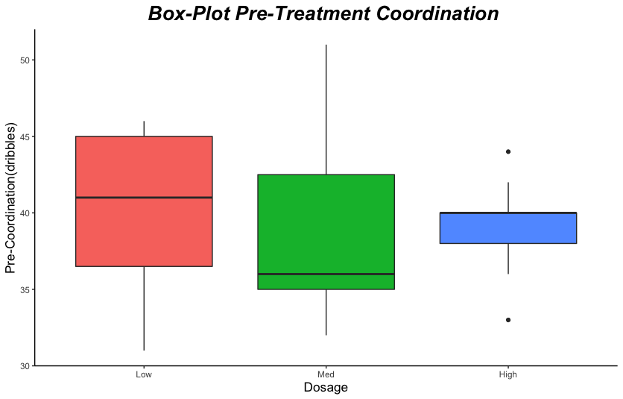
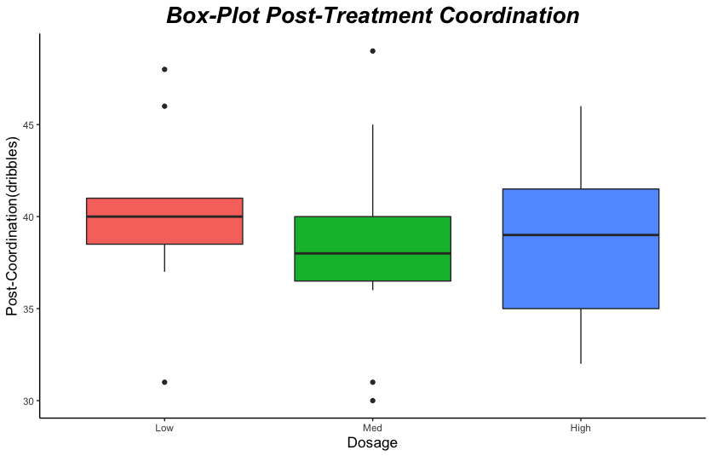
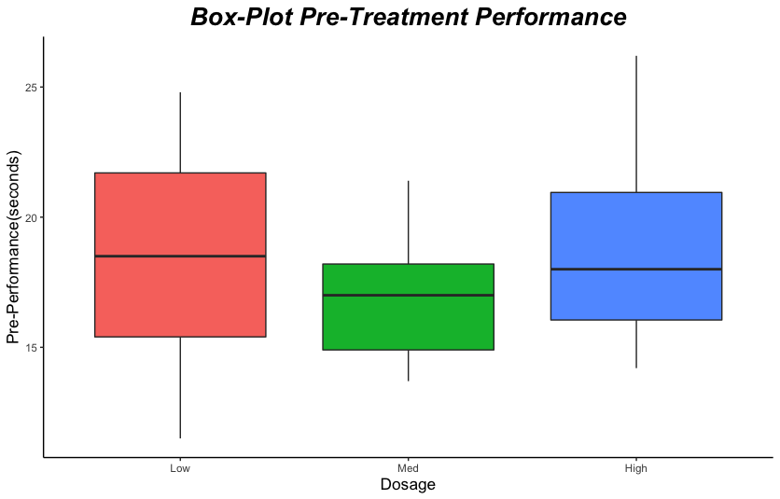
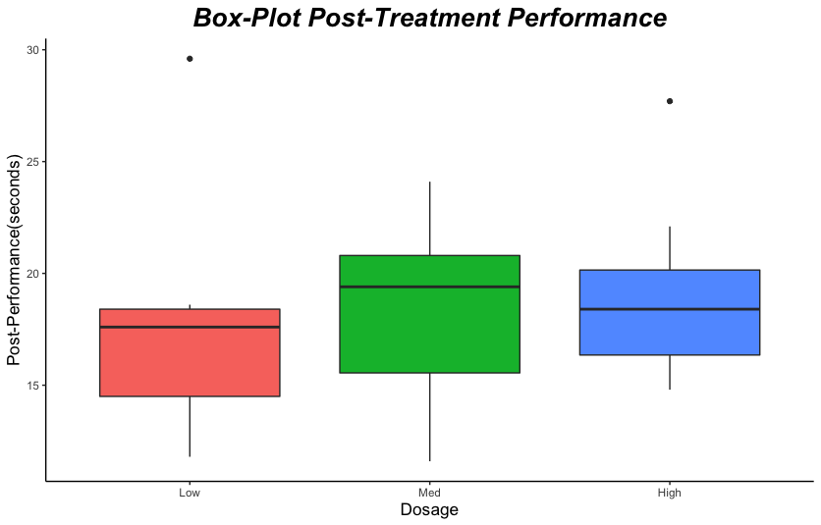
ANALYSIS
SUMMARY
CONTROL(MALE)
25

Slide 26
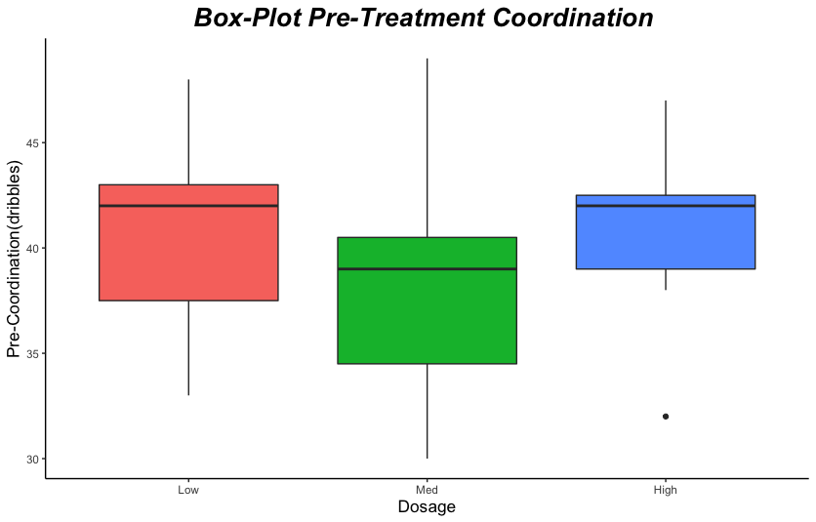
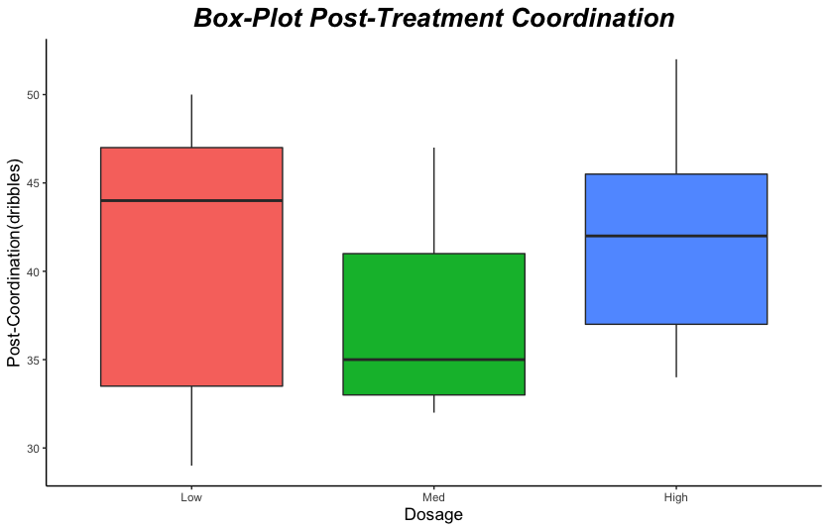
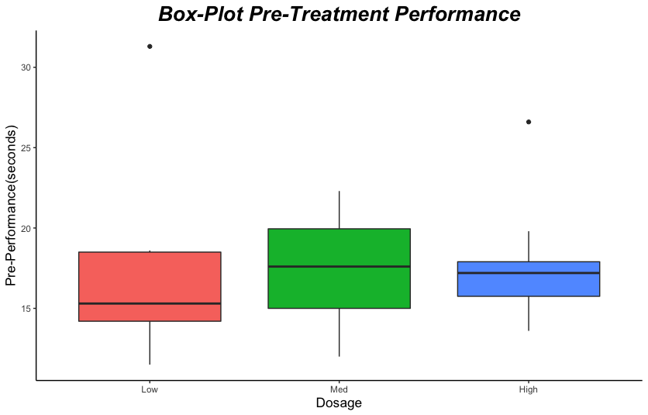
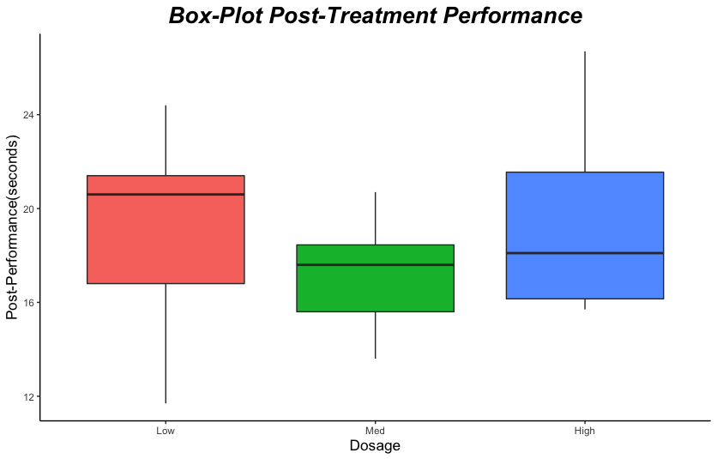
ANALYSIS
SUMMARY
ALCOHOL(MALE)
26

Slide 27
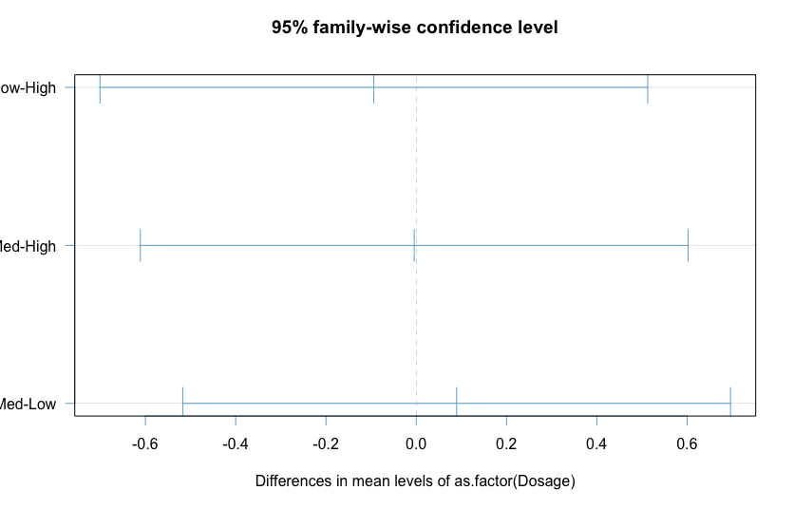
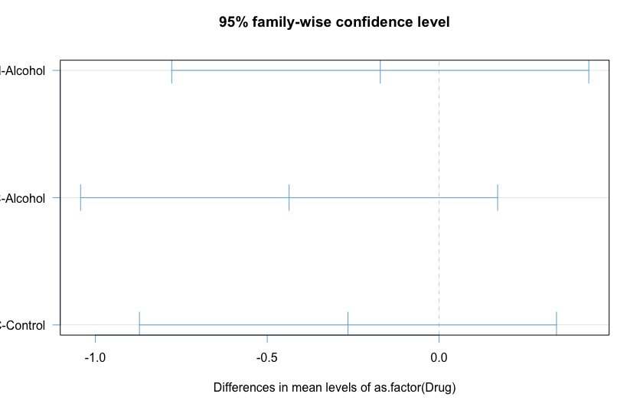
TukeyHSD (Perf.)

